Slide 1
Deep Neural Network
Dr. Monali Mavani
Delivered by Prof. Aakash Goel

Slide 2

Deep Neural Network
Disclaimer and Acknowledgement
The content for these slides has been obtained from books and various other source on the Internet
I here by acknowledge all the contributors for their material and inputs.
I have provided source information wherever necessary
I have added and modified the content to suit the requirements of the course

Slide 3
Course Logistics

Slide 4
What we Learn…. (Module Structure)
Handout………
Notes:
Talk about each topic in 1 or 2 sentences.

Slide 5
Books
Textbook
Dive into Deep Learning by Aston Zhang, Zack C. Lipton, Mu Li, Alex J. Smola. https://d2l.ai/chapter_introduction/index.html
Reference book
Deep Learning by Ian Goodfellow, Yoshua Bengio, Aaron Courville https://www.deeplearningbook.org/
Notes:
The text book is freely available for download

Slide 6
Evaluation Components and Schedule
 | Evaluation Component | Mode | Duration | Weightage | Date and Time
EC1 | Quiz I* | Online | 30 Mins | 10% | Refer to LMS
 | Quiz II* |  | 30 Mins | 10%
 | Assignment 01 |  | 4 Weeks | 10%
 | Assignment 02 |  | 4 Weeks | 10%
EC2 | Mid-sem exam (Closed book) |  | 2 Hours | 30%
EC3 | Comprehensive exam (Open book) |  | 2.5 Hours | 40%
* Best of Two

Slide 7
Course Logistics
Refer Taxila for the following
Handout
Schedule for Webinar
Schedule of Quiz, and Assignments.
Evaluation scheme
Session Slide Deck
Demo Lab Sheets
Quiz-I, Quiz-II
Assignment-I, Assignment-II
Sample QPs
Lecture Recordings
Available on Microsoft teams

Slide 8
Honour Code
All submissions for graded components must be the result of your original effort. It is strictly prohibited to copy and paste verbatim from any sources, whether online or from your peers. The use of unauthorized sources or materials, as well as collusion or unauthorized collaboration to gain an unfair advantage, is also strictly prohibited. Please note that we will not distinguish between the person sharing their resources and the one receiving them for plagiarism, and the consequences will apply to both parties equally.
In cases where suspicious circumstances arise, such as identical verbatim answers or a significant overlap of unreasonable similarities in a set of submissions, will be investigated, and severe punishments will be imposed on all those found guilty of plagiarism.

Slide 9
What is Deep Learning?

Slide 10
Definitions of Deep Learning
Deep Learning is a type of machine learning based on artificial neural networks in which multiple layers of processing are used to extract progressively higher-level features from data.
Deep learning is a method in artificial intelligence (AI) that teaches computers to process data in a way that is inspired by the human brain.
Deep learning is a machine learning technique that teaches computers to do what comes naturally to humans: learn by example.
Deep learning is a subset of machine learning, which is essentially a neural network with three or more layers.
Deep Learning gets its name from the fact that we add more "Layers" to learn from the data.

Slide 11
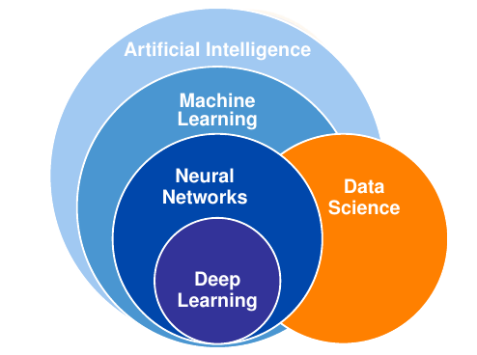
Where in AI sits DL?
Deep Learning: neural network with three or more layers
AI is a general field that encompasses machine learning and deep learning, but that also includes many more approaches that don’t involve any learning.
Notes:
AI : Artificial intelligence is the science of making things smart. The aim is make machines perform human tasks. Eg: Robot cleaning a room.
ML : Machine learning is an approach to AI. The machine learns or perform tasks through learning by experience.
DL : Deep Learning is a technique for implementing machine learning to recognise patterns.

Slide 12
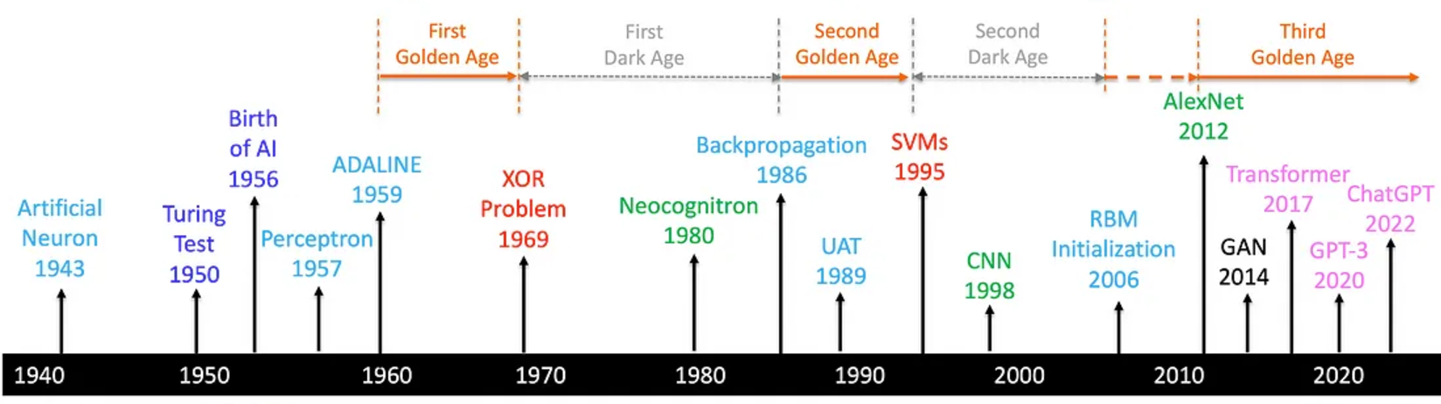
Deep Learning Timeline
Notes:
For reading for the studentsThe Turing Test, proposed by British mathematician and logician Alan Turing in his seminal 1950 paper "Computing Machinery and Intelligence", is a method to determine whether a machine can exhibit intelligent behavior indistinguishable from that of a human.

Slide 13
Why Deep Learning?
Large amounts of data
Lots and lots of unstructured data like images, text, audio, video
Cheap, high-quality sensors
Cheap computation - CPU, GPU, Distributed clusters
Cheap data storage
Learn by examples
Automated feature generation
Scalability

Slide 14
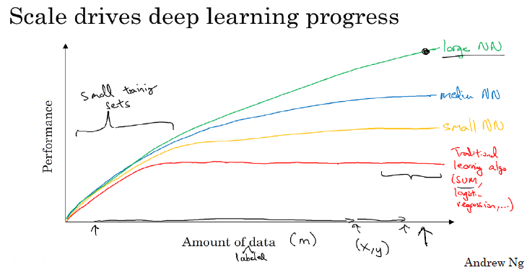
Why deep learning?
Notes:
As the amount of data grows, traditional learning algo do not give better performance. Larger (means deeper) the NN, better the performance, as the amount of data grows.

Slide 15
Applications of Deep Learning

Slide 16
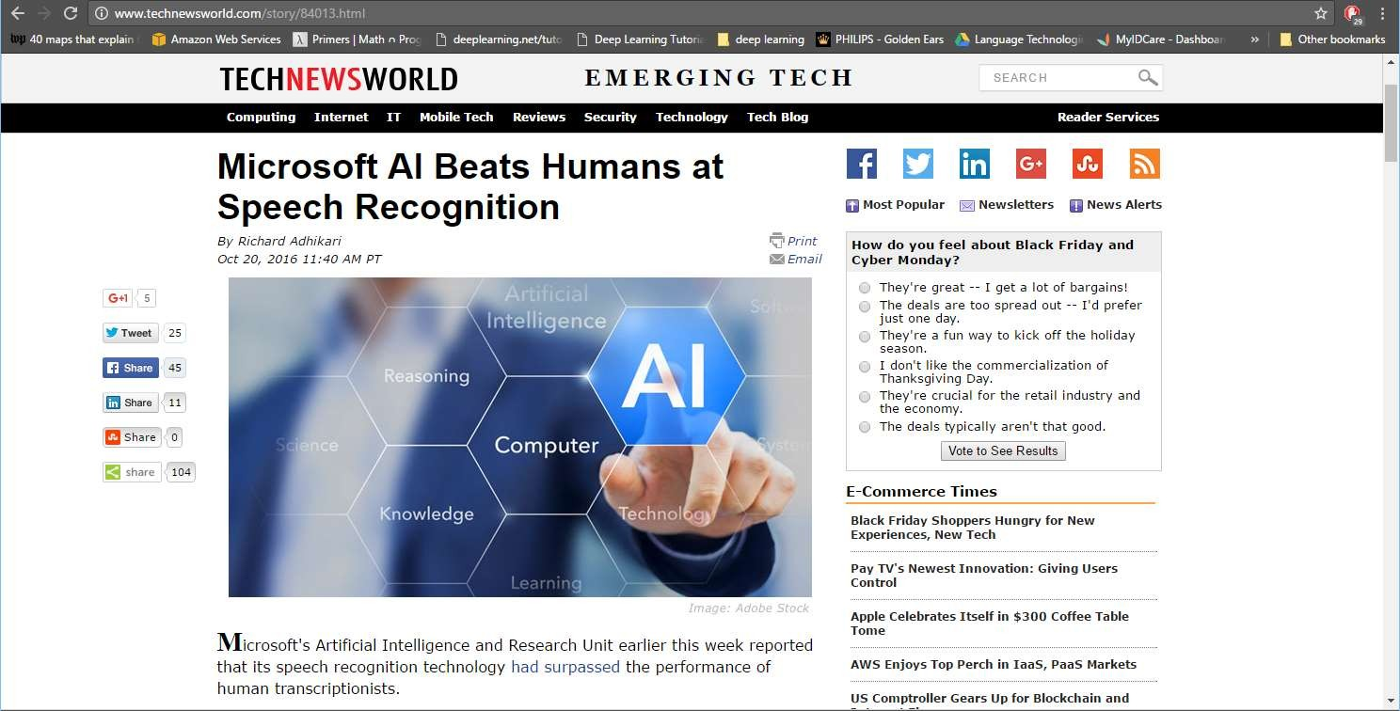
Breakthroughs with neural networks
Slide credit: 11-785 Introduction to Deep Learning, CMU

Slide 17

Breakthrough with neural networks
21
Slide credit: 11-785 Introduction to Deep Learning, CMU

Slide 18
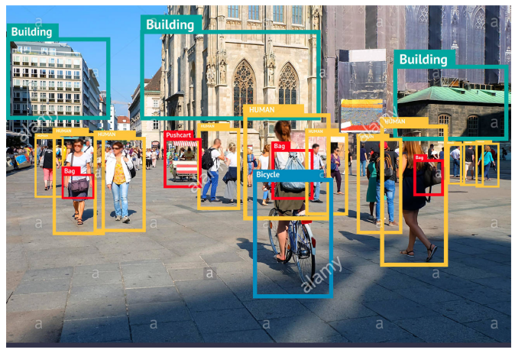
Image segmentation and recognition
22

Slide 19
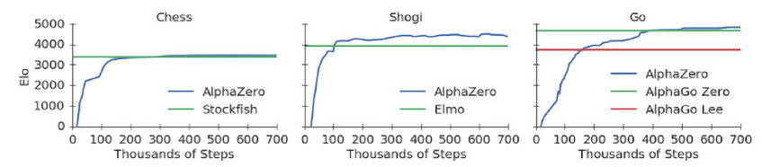
Breakthroughs with neural networks
Google DeepMind’s AI system, AlphaGo, learned to master the ancient Chinese game of Go — complex board game of strategy,
AlphaGo –In October 2015, the original AlphaGo became the first computer Go program to beat a human professional Go player
AlphaGo Zero - completely self-taught without learning from human games.
AlphaGo Zero – Played Chess and Shogi
23

Slide 20
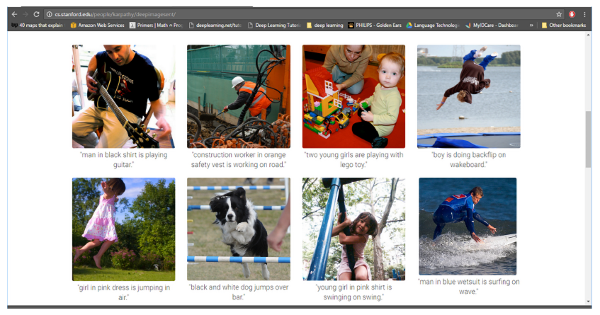
Success with neural networks
The result of an image captioning task from 2015
24

Slide 21
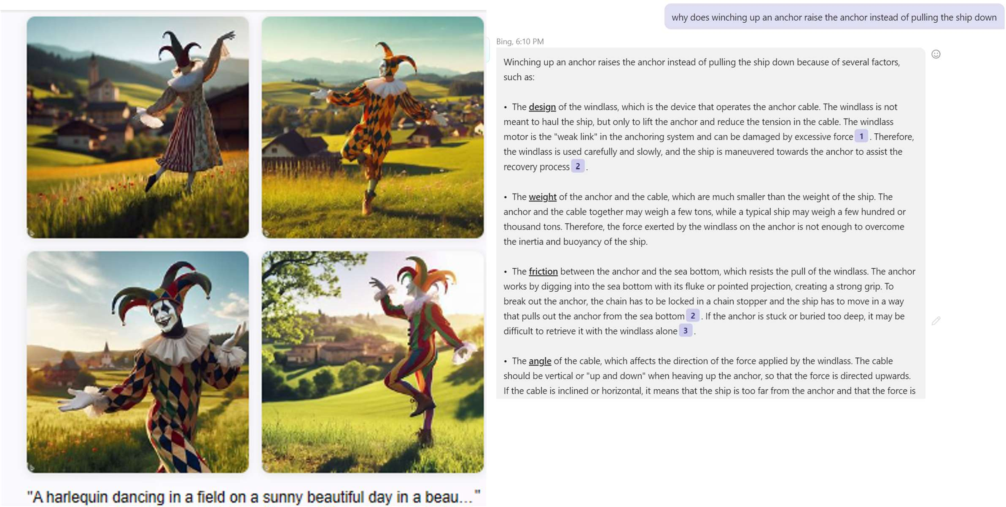
Breakthroughs with neural networks
Stable Diffusion
ChatGPT
Slide credit: 11-785 Introduction to Deep Learning, CMU
Notes:
Stable Diffusion is a deep generative model that creates realistic images from text prompts. It belongs to the family of latent diffusion models (LDMs) and was released by Stability AI in collaboration with researchers from LMU Munich and Runway in 2022.
Stable Diffusion generates images by "diffusing" noise and then "de-noising" it based on your text prompt, all within a compressed latent space — making it faster and more efficient than earlier pixel-space models.

Slide 22
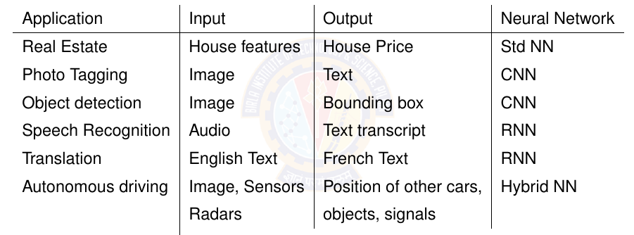
Applications of Deep Learning

Slide 23
Many more applications….
a program that predicts tomorrowʼs weather given geographic information, satellite images, and a trailing window of past weather.
a program that takes in a question, expressed in free-form text, and answers it correctly.
a program that given an image can identify all the people it contains, drawing outlines around each.
a program that presents users with products that they are likely to enjoy but unlikely, in the natural course of browsing, to encounter.
Notes:
Highlight that the input for each of the above are unstructured data like images, text, and web stream clicks. It also involves, looking for a pattern
that changes over time, and we need our programs to adapt. The relationship (say between pixels, and abstract categories) may be too complicated,

Slide 24
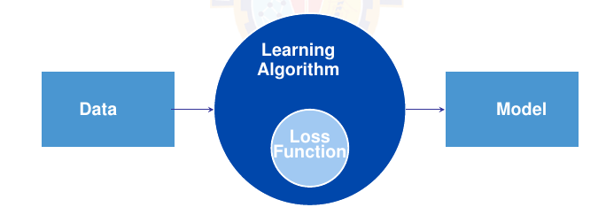
Core components of DL problem
The data that we can learn from.
A model of how to transform the data. – Learning Algorithm
An objective function that quantifies how well (or badly) the model is doing. – Loss Function
An algorithm to adjust the modelʼs parameters to optimize the objective function. - Optimization Algorithm
Notes:
Dimensionality of data
Each example has the same number of numerical values. This data consist of fixed-length vectors. Eg: Image
The constant length of the vectors as the dimensionality of the data.
Text data has varying-length data.
Optimization Algorithm is an algorithm capable of searching for the best possible parameters for minimizing the loss function.
Popular optimization algorithms for deep learning are based on an approach called gradient descent.

Slide 25

Data
Collection of examples.
Data has to be converted to an useful and a suitable numerical representation.
Each example (or data point, data instance, sample) typically consists of a set of attributes called features (or covariates), from which the model must make its predictions.
In the supervised learning problems, the attribute to be predicted is designated as the label (or target).
Mathematically, a set of m examples,
We need right data.
Notes:
We need the right data. – The data they handle might include bias (from multiple sources) which the model can capture, this can result in undesired consequences.

Slide 26
Data
Dimensionality of data
Each example has the same number of numerical values. This data consist of fixed-length vectors. Eg: Image
The constant length of the vectors as the dimensionality of the data.
Text data has varying-length data.

Slide 27
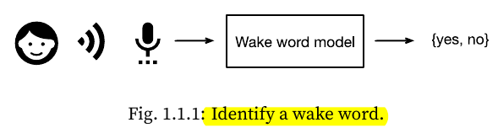
2. Model
Model denotes the computational machinery for ingesting data of one type, and spitting out predictions of a possibly different type.
Deep learning models consist of many successive transformations of the data that are chained together top to bottom, thus the name deep learning.
Notes:
Wake word is Alexa, Hey Siri, Hey Google,
Another example of face recognition where input is image and output is again yes/no. Finger print recognition

Slide 28
3. Objective Function
Learning means improving at some task over time.
A formal mathematical system of learning machines is defined using formal measures of how good (or bad) the models are. These formal measures are called as objective functions.
By convention, objective functions are defined so that lower is better.
Because lower is better, these functions are sometimes called loss functions.
Notes:
You can take any function for which higher is better, and turn it into a new function that is qualitatively identical but for which lower is better by flipping the sign.
squared error is the square of the difference between the prediction and the ground-truth.

Slide 29
3. Loss Functions
To predict numerical values (regression), the most common loss function is squared error.
For classification, the most common objective is to minimize error rate, i.e., the fraction of examples on which our predictions disagree with the ground truth.

Slide 30
3. Loss Functions
Loss function is defined with respect to the model parameters and depends upon the dataset.
We learn the best values of our model parameters by minimizing the loss incurred on a set consisting of some number of examples collected for training. However, doing well on the training data does not guarantee that we will do well on unseen data. I.e Model has to generalize better.
When a model performs well on the training set but fails to generalize to unseen data, we say that it is overfitting.
Notes:
So we will typically want to split the available data into two partitions: the training dataset (or training set, for fitting model parameters) and the test dataset (or test set, which is held out for evaluation), reporting how the model performs on both of them.
You could think of training performance as being like a studentʼs scores on practice exams used to prepare for some real final exam. Even if the results are encouraging, that does not guarantee success on the final exam. In other words, the test performance can deviate significantly from the training performance.

Slide 31
4. Optimization Algorithms
Optimization Algorithm is an algorithm capable of searching for the best possible parameters for minimizing the loss function.
Popular optimization algorithms for deep learning are based on an approach called gradient descent.

Slide 32
Example of the Framework
We have to tell a computer explicitly how to map from inputs to outputs.
We have to define the problem precisely, pinning down the exact nature of the inputs and outputs, and choosing an appropriate model family.
Collect a huge dataset containing examples of audio and label those that do and that do not contain the wake word.

Slide 33
Example of the Framework
Create a Model
Define a flexible program whose behavior is determined by a number of parameters.
To determine the best possible set of parameters, use the data. The parameters should improve the performance of the program with respect to some measure of performance on the task of interest.
After fixing the parameters, we call the program a model.
Eg: The model receives a snippet of audio as input, and the model generates a selection among yes, no as output.
The set of all distinct programs (input-output mappings) that we can produce just by manipulating the parameters is called a family of models.
Eg: We expect that the same model family should be suitable for ”Alexa” recognition and ”Hey Siri” recognition because they seem, intuitively, to be similar tasks.

Slide 34
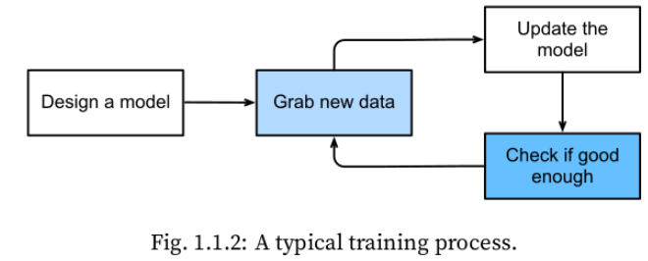
Example of the Framework
The meta-program that uses our dataset to choose the parameters is called a learning algorithm.
In machine learning, the learning is the process by which we discover the right setting of the parameter coercing the desired behavior from our model.
Train the model with
data.

Slide 35
Artificial Neural Networks

Slide 36
Neural networks
Neural networks originally began as computational models of the brain, or more generally, models of Cognition
Humans learn through association
The earliest model of cognition was Associationism
Associationism was followed by Connectionism

Slide 37
What are “Associations”
Lightning is generally followed by thunder
Ergo – “hey here’s a bolt of lightning, we’re going to hear thunder”
Ergo – “We just heard thunder; did someone get hit by lightning”?
But where are the associations stored??
And how?

Slide 38
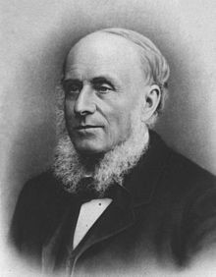
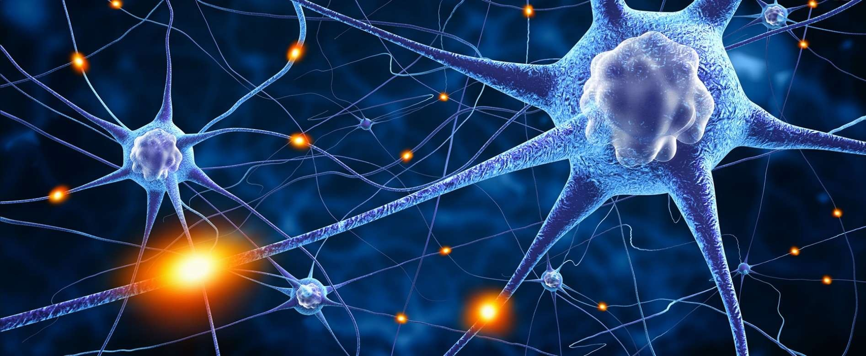
Enter Connectionism
Alexander Bain, philosopher, psychologist, mathematician, logician, linguist, professor
1873: The information is in the connections
– Mind and body (1873)
Neurons connect to other neurons.
The processing/capacity of the brain is a function of these connections
Connectionist machines emulate this structure
41

Slide 39
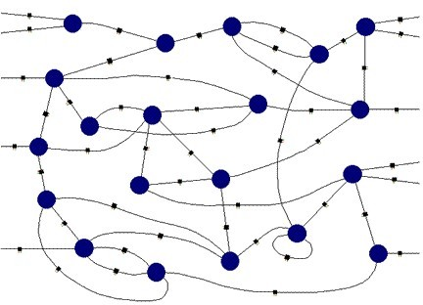
Connectionist Machines
Network of processing elements
All world knowledge is stored in the connections between the elements
But what are the individual elements?
47

Slide 40
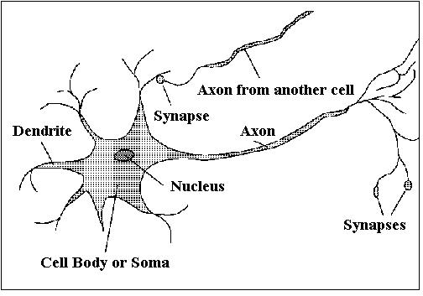
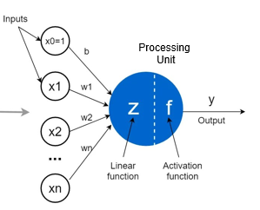
Biological Neuron Vs Artificial Neuron
The Human brain - Interconnected Neurons
Dendrite: Receives signals from other neurons
Soma: Processes the information
Axon: Transmits the output of this neuron
Synapse: Point of connection to other neurons
Biological Neuron | Artificial Neuron
Cell Nucleus (Soma) | Node
Dendrites | Input
Synapse | Weights or interconnections
Axon | Output
Notes:
Neuron is a processing element inspired by how the brain works.
Similar to biological neuron, each artificial neuron will be do some computation. Each neuron is interconnected to other neurons.
Similar to brain, the interconnections between neurons store the knowledge it learns. The knowledge is stored as parameters.

Slide 41
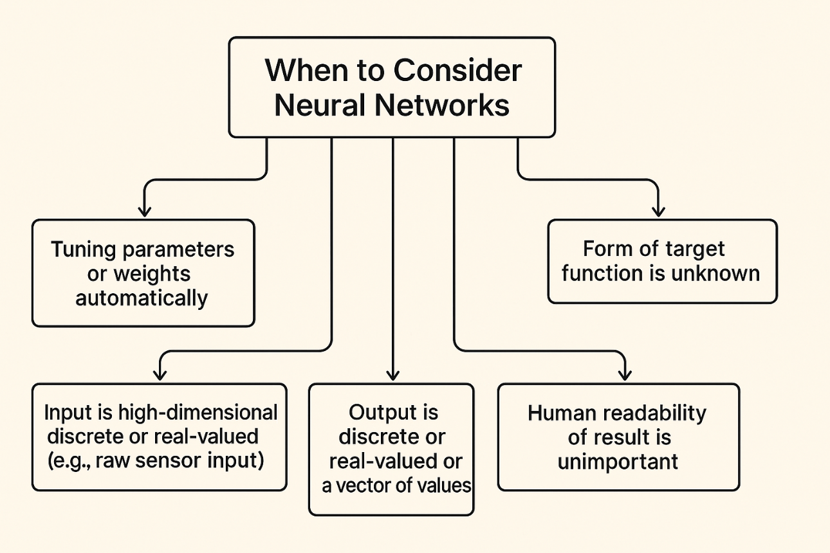
Artificial Neural Nets (ANNs)
Many neuron-like threshold switching units.
Many weighted interconnections among units.
Highly parallel, distributed process.
Examples:
Speech phoneme recognition
Image classification
Financial prediction
Notes:
Meaning: Neural networks are robust to noise — small errors in input don't drastically affect the output if trained properly.
Why it matters:
Real-world data is messy: sensors malfunction, humans make labeling mistakes.
Neural nets learn general patterns, not exact memorization.
Example:
A few mislabelled cats in a dataset won't stop a neural network from learning what a cat usually looks like.
Output is discrete or real-valued or a vector of values
Meaning: Neural networks can predict:
Discrete outputs (classification: "cat" or "dog")
Continuous outputs (regression: predict a house price)
Vector outputs (e.g., bounding box coordinates in object detection)
Why it matters:
They are versatile: one architecture can solve different types of problems by simply changing the final layer and loss function.
Example:
In language models: output is a probability vector over a vocabulary.
In self-driving cars: output might be a real-valued steering angle.
Input is high-dimensional discrete or real-valued (e.g., raw sensor input)
Meaning: Neural networks handle inputs with many features (high-dimensional) and can work with both:
Real-valued inputs (e.g., temperature readings, pixel values)
Discrete/categorical inputs (e.g., categories encoded as one-hot vectors)

Slide 42
Perceptron

Slide 43
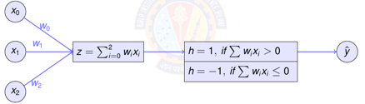
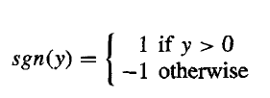

Perceptron
One type of ANN system is based on a unit called a perceptron.
A perceptron takes a vector of real-valued inputs, calculates a linear combination of these inputs, then outputs a 1 if the result is greater than some threshold and -1 otherwise.
Notes:
Highlight that perceptron will have outputs as +1 and -1 always.

